Slide 1
Distributed Process Management

Slide 2
DISTRIBUTED PROCESS MANAGEMENT
Goal: Make the best possible use of the processing resources of the entire system sharing them among all processes.
Three Concepts:
Process allocation – which process to which processor
Process Migration – from current location to the processor to another one
Threads – for better utilization of the processing capacity of the system
*

Slide 3
PROCESS ALLOCATION
A resource manager schedules the processes to make use of the system resources so that the usage, response time, network congestion, and scheduling overheads are minimized
Three technique types:
Task assignment approach – processes divided into tasks that are scheduled to suitable nodes (Not popular because it does not take of the dynamic nature of processes)
Load-balancing approach – equalizing the workload among the nodes
Load-sharing approach – no node should be idle
*

Slide 4
Scheduling Algorithms
Desirable features of a good global scheduling algorithm
No a priori knowledge about the processes to be executed
Dynamic in nature to take care of dynamically changing nature of loads in various nodes
Quick decision-making capability to make quick decisions about the assignment of processes to processors
Balanced system performance and scheduling overhead – provide near optimal system performance with a minimum of global state information gathering
Stability –avoid processor thrashing (all nodes of the system are spending all the time migrating processes without accomplishing any useful work)
Scalability – should handle both large and small networks
Fault tolerance – should not be disabled by the crash of one or more nodes of the system
Fairness of Service to the users
*

Slide 5
Task Assignment Approach
The goal here is to find an optimal assignment policy for the tasks of an individual process assuming the following:
A process has already been split into tasks
The amount of computation time required by each task and speed of each processor is known
The cost of processing each task on every node is of the system is known
The Interprocess Communication (IPC) costs between every pair of tasks in known
Other constraints such as resource requirements of tasks and the available resources at each node. Precedence relationships among tasks, and so on are also know
Reassignment of tasks is generally not possible
*

Slide 6
Task Assignment Approach
Therefore, the task assignment algorithm should achieve the following goals:
Minimization of IPC costs
Quick turnaround time for the complete process
A high degree of parallelism
Efficient utilization of system resources
Read on “Finding an Optimal Assignment”
*

Slide 7
Load Balancing Approach
Load-balancing/load-leveling algorithms try to balance the total system load by transparently transferring the workload from heavily loaded nodes to lightly loaded notes in an attempt to ensure good overall performance relative to some specific metric of system performance.
*

Slide 8
Static – use only average behavior of the system, ignoring the current state of the system, hence simple but limited potential.
Dynamic – react to the system state that changes dynamically. These are more complex and ensure better performance
*

Slide 9
Load-Balancing Algorithms
Deterministic – uses information about the properties of the nodes and the characteristics of the processes to deterministically allocated nodes to processes; e.g.. Task Assignment algorithms
Probabilistic – uses information regarding static attributes of the system to formulate simple process placement rules
Centralized – a central server node carries out the scheduling
Distributed – the scheduling intelligence is distributed on all the nodes
Non-cooperative – individual entities act as autonomous entities and make scheduling decisions independently.
Cooperative – entities cooperate with each other to make scheduling decisions
*

Slide 10
Issues in Designing Load-Balancing Algorithms
Load Estimation Policies– decide on a method to be used to estimate the workload on a particular node
State Transfer Policies– Devise a policy to decide whether a node is lightly loaded or heavily loaded
State Information Exchange Policies – to manage the frequent exchange of state information.
Location Policies – to chose a destination node
Priority Assignment Policies –to device a priority assignment rule.
Migration Limiting Policy to determine the total number of times a process should be allowed to migrate

Slide 11
Load Sharing Approach
Design of algorithms will depend on proper decisions regarding:
Load estimation policy – best done by measuring CPU utilization
Process transfer policy
Location policies
*

Slide 12
Process Migration
Transfer of sufficient amount of the state of a process from one machine to another
The process executes on the target machine

Slide 13
Motivation
Load sharing
Move processes from heavily loaded to lightly loaded systems
Load can be balanced to improve overall performance
Communications performance
Processes that interact intensively can be moved to the same node to reduce communications cost
May be better to move process to where the data reside when the data is large

Slide 14
Motivation
Availability
Long-running process may need to move because the machine it is running on will be down
Utilizing special capabilities
Process can take advantage of unique hardware or software capabilities

Slide 15
Initiation of Migration
Operating system
When goal is load balancing
Process
When goal is to reach a particular resource

Slide 16
What is Migrated?
Must destroy the process on the source system and create it on the target system
Process control block and any links must be moved

Slide 17
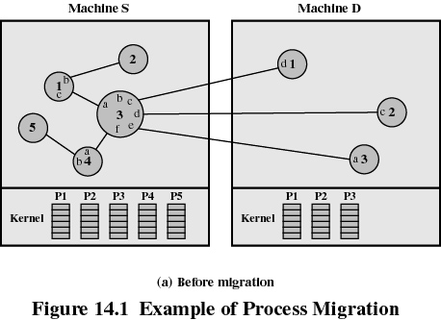

Slide 18
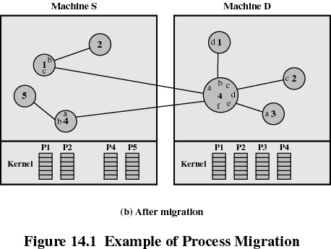

Slide 19
Process Migration
Time
Selecting a process to be migrated
Selecting the destination node
Suspending the process
Capturing the process state
Sending the state to the destination
Resuming the process
Forwarding future messages to the destination
Source Site
Destination Site
Process P1
:
:
:
:
Execution
suspended
Freezing
time
Transfer of
control
Execution
Resumed
:
:
:
:
Process P1

Slide 20
Process Migration - State Capturing
CPU registers
Captured upon a freeze
Address space
Difficult to restore pointers
I/O state:
Fast I/O Operations
Completed before a process migration
Durable I/O Operations like files and user interactions
Difficult to carry files in use and to freeze/restore system calls.
Necessity to maintain a connection with I/O established at the source node.
Some popular files available at the destination node

Slide 21
Process Migration - Address Transfer Mechanisms
Total Freezing
Pretransferring/Precopy
Transfer-on-reference
Source
node
Destination
node
Source
node
Destination
node
Source
node
Destination
node
Migration
decision
Migration
decision
Suspended
Migration
decision
Suspended
Freezing
time
Transfer of
address space
Transfer of
address space
On-demand
transfer
Freezing
time
Suspended
Freezing
time
resumed
resumed
resumed
Merits: easy implementation
Demerits: long delay time
Application: DEMO/MP, Sprite, LOCUS
Merits: freezing time reduce
Demerits: total time extended
Application: V-System
Merits: quick migration
Demerits :Continued load on
Source, remote memory access
Application: Accent

Slide 22
Process Migration - Message Forwarding Mechanisms
To ensure that messages meant for the migrated process reach the new destination
Ask origin site
Origin
Resending messages
Origin
Sender
Receiver
Sender
Send
Receiver
Send
Migrate
Resend
Migrate
Forward
Dest 1
Dest 1
Resend again
Migrate again
Migrate again
Dest 2
Dest 2

Slide 23
Process Migration - Message Forwarding Mechanisms (Cont’d)
Link traversal
Link Update
Origin
Origin
Sender
Receiver
Sender
Receiver
Send
Send
Forward
New location
Send
Link
Migrate
Migrate
Send
Dest 1
Dest 1
Forward
New location
Link
Migrate again
Send
Migrate again
Dest 2
Current location
Dest 2
The source node sends link-update messages to the kernels controlling all the migrant process’s communication partners

Slide 24
What is Migrated?
Eager (all/Total Freezing): Transfer entire address space
No trace of process is left behind
If address space is large and if the process does not need most of it, then this approach my be unnecessarily expensive

Slide 25
What is Migrated?
Pre-copy (pre-transferring ): Process continues to execute on the source node while the address space is copied
Pages modified on the source during pre-copy operation have to be copied a second time
Reduces the time that a process is frozen and cannot execute during migration

Slide 26
What is Migrated?
Dirty (Transfer on Reference) Transfer only that portion of the address space that is in main memory and have been modified
Any additional blocks of the virtual address space are transferred on demand
The source machine is involved throughout the life of the process

Slide 27
What is Migrated?
Flushing: Pages are cleared from main memory by flushing dirty pages to disk
Relieves the source of holding any pages of the migrated process in main memory

Slide 28
Negotiation of Migration
Migration policy is the responsibility of Starter utility
Starter utility is also responsible for long-term scheduling and memory allocation
Decision to migrate must be reached jointly by two Starter processes (one on the source and one on the destination)

Slide 29
Eviction
System evicts a process that has been migrated to it
If a workstation is idle, process may have been migrated to it
Once the workstation is active, it may be necessary to evict the migrated processes to provide adequate response time

Slide 30
Process Migration - Heterogeneous Systems
Using external data representation
Floating-point data
External data representation must have at least as much space as the longest floating-point data representation
Process migration is restricted to only the machines that can avoid the over/underflow and the loss of precision.
Architectural-dependent data representation
Signed-infinity (Value supported by some architectures that indicates that the generated result is too large/small to store) and signed-zero
In general, process migration over heterogeneous systems are too expensive
Conversion work
Architectural-dependent representation handling

Slide 31
End
Questions???

